Slide 1
Information Design
DEI 613 Assignment 1
September 2026, Annie Ngu

Slide 2
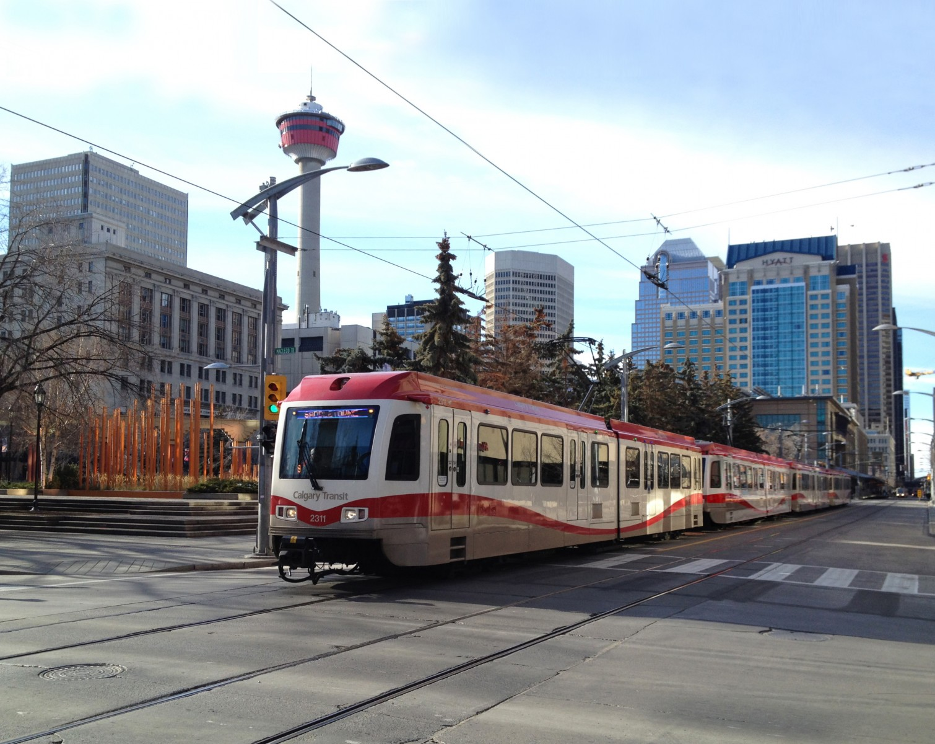
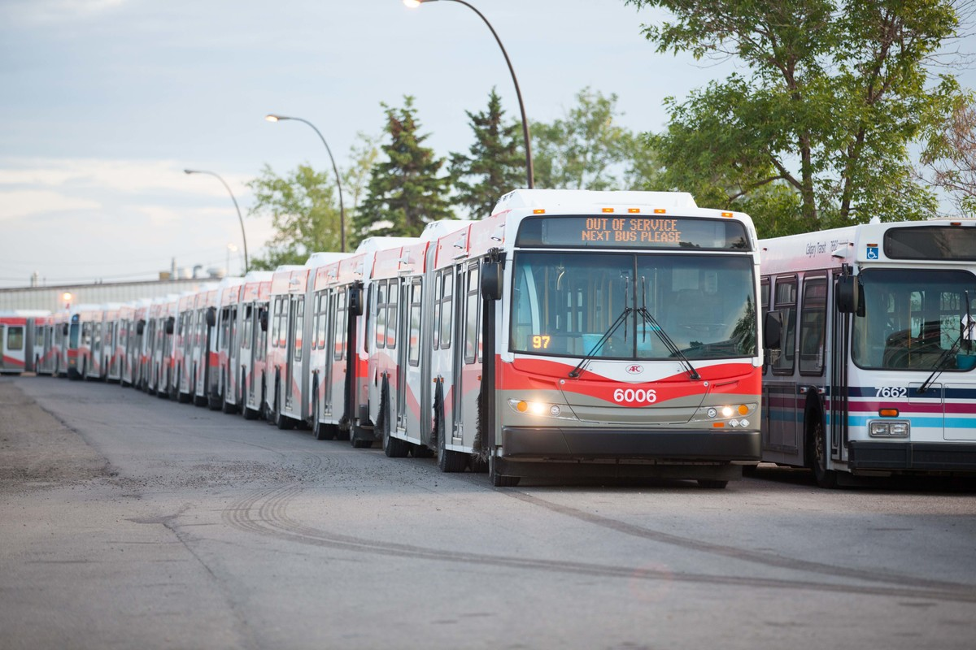
Context
Notes:
So living in Calgary almost my whole life, transit has been part of my daily routine for all of my teenage years and early adult life. For this project, I chose the Calgary Transit Ridership dataset focusing on 17 complete years from 2007 through 2024.

Slide 3
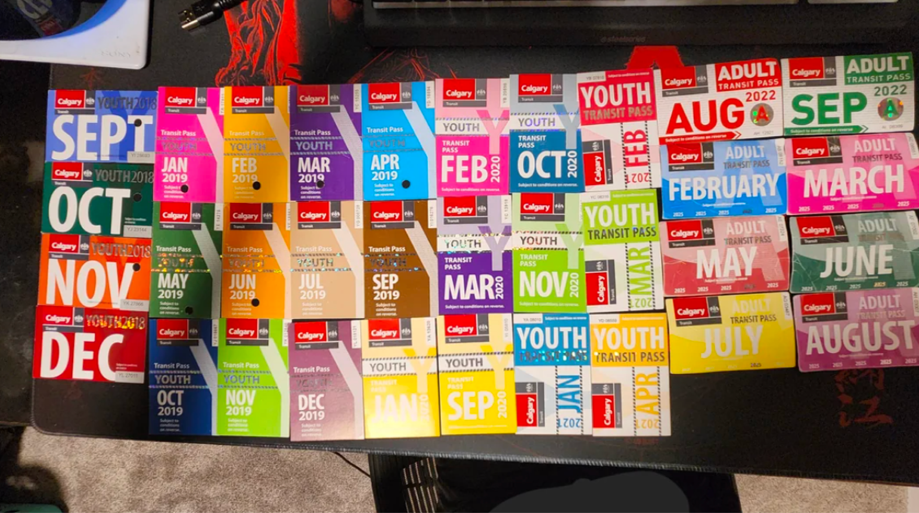
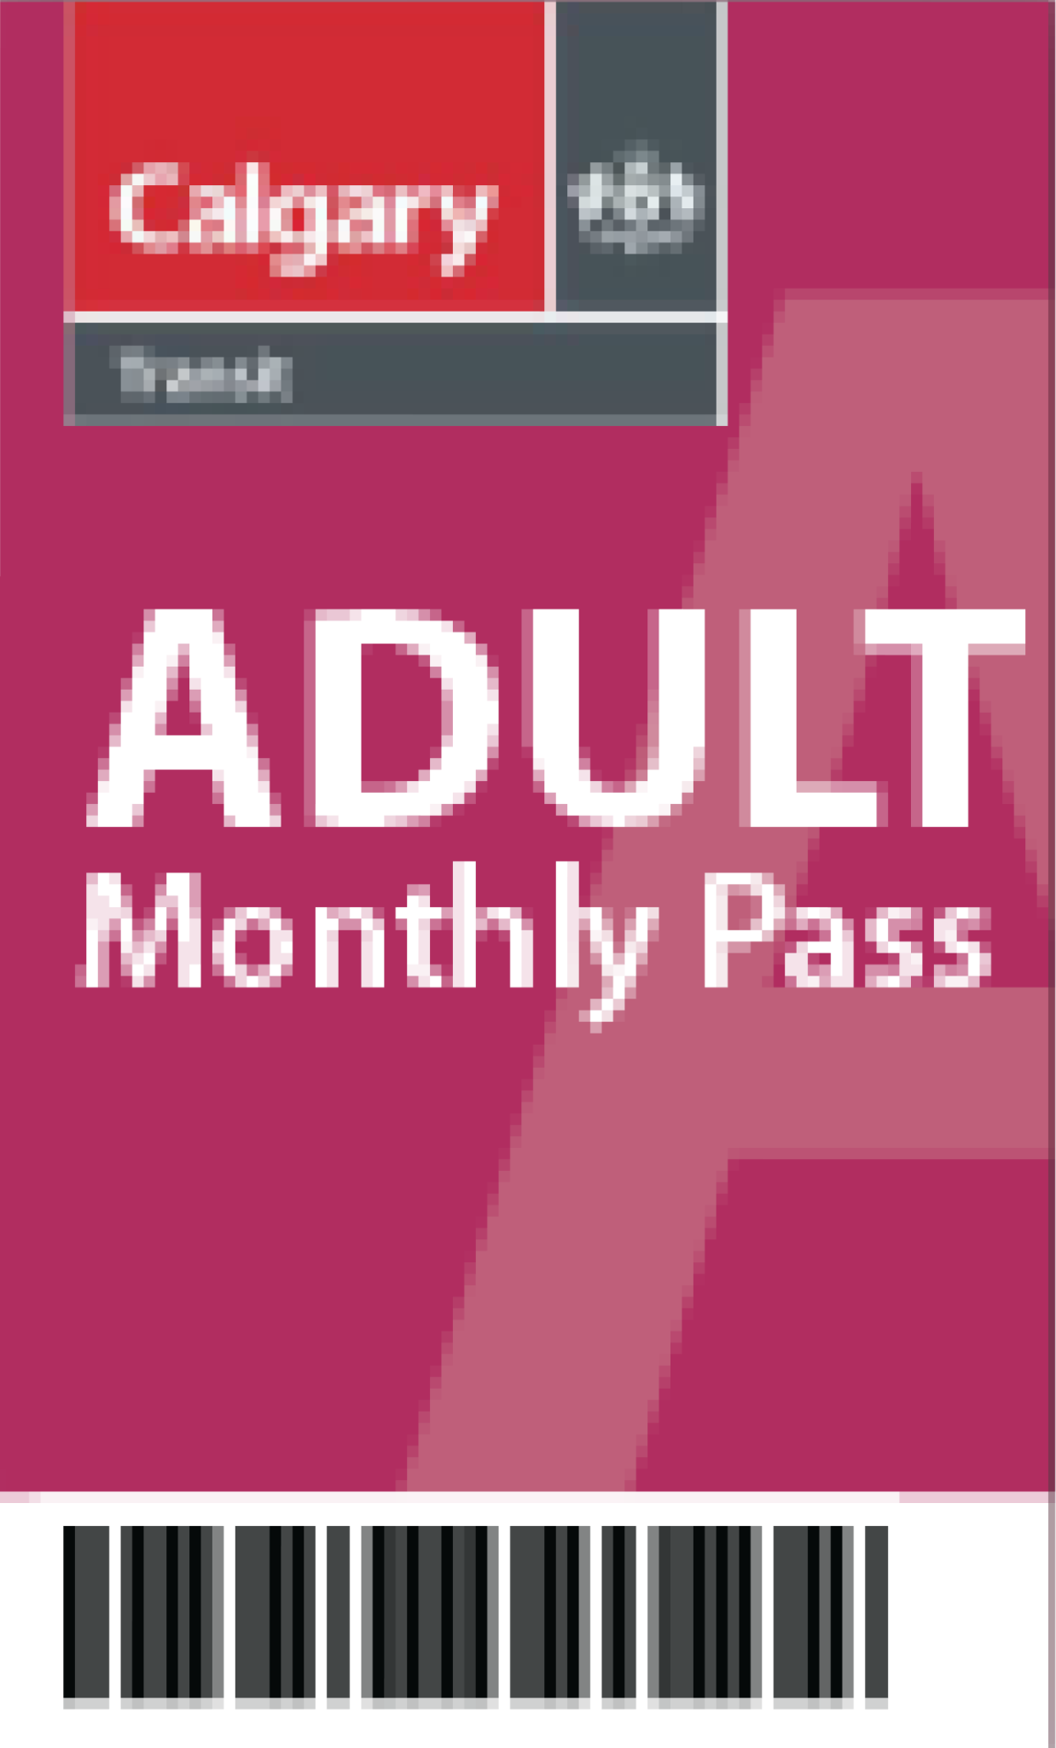
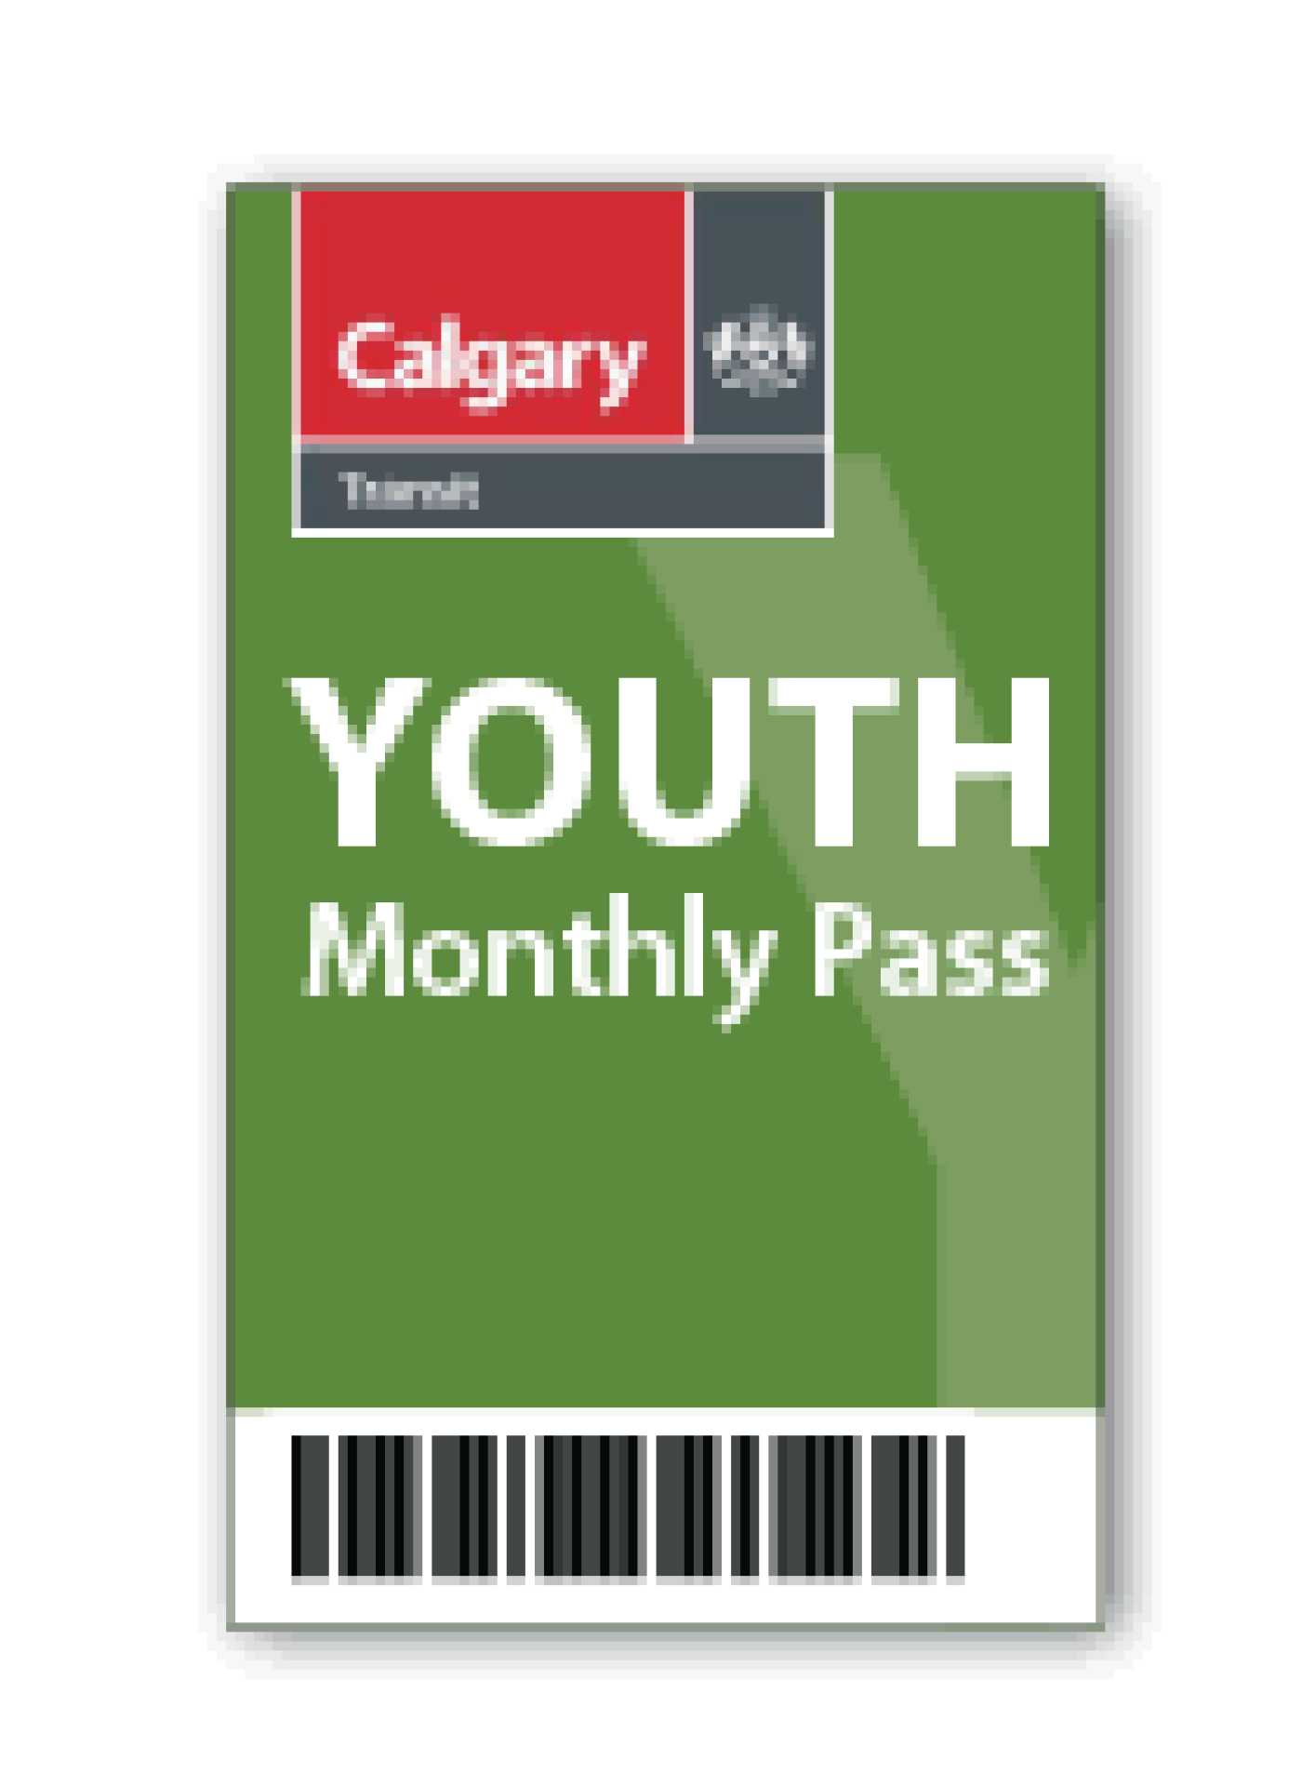

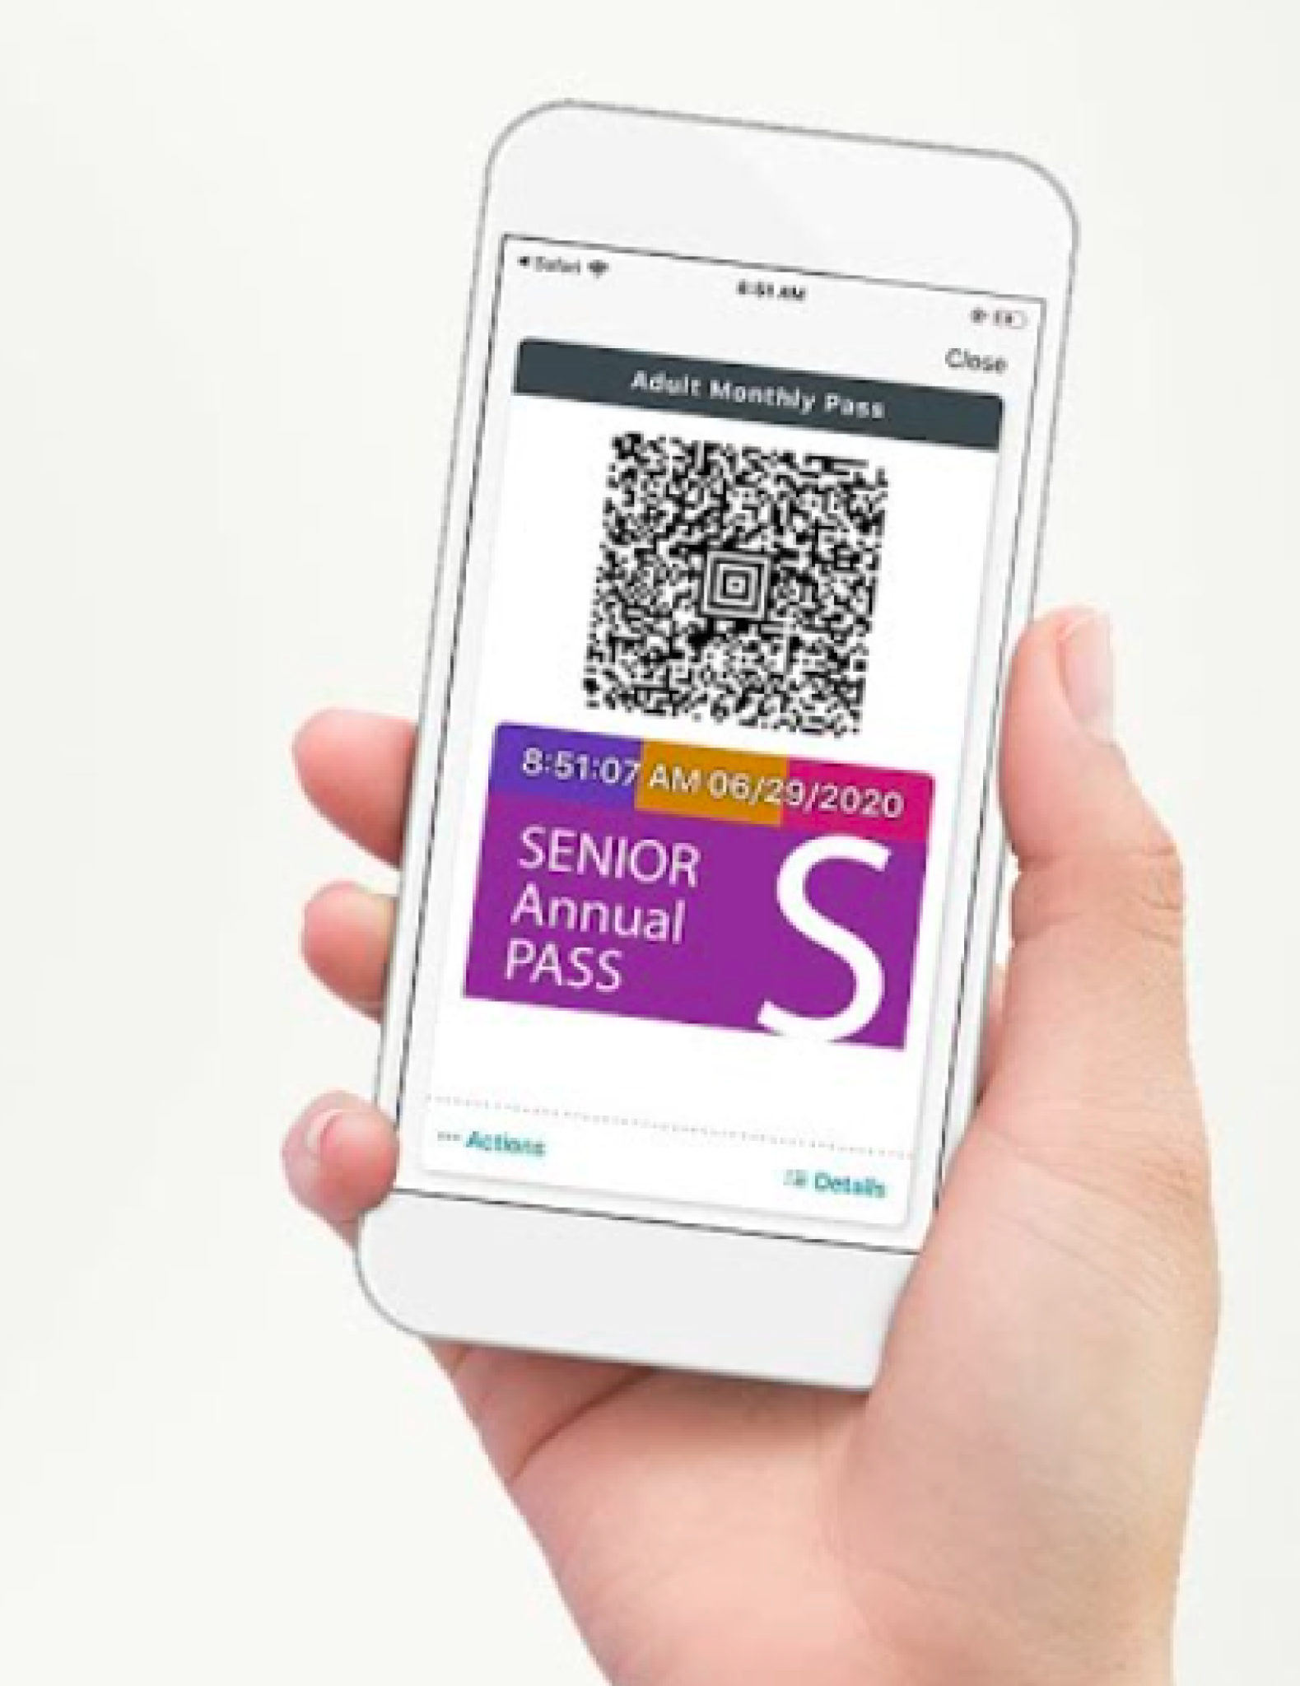
Moodboard/inspo
Notes:
Rather than looking at mode splits—since according to the data, majority of all commutes combine both the bus and LRT C-Train system—I combined total ridership and broke it down by the official subgroups. I decided to leave out the Low Income subgroup data, because there had been a few changes over the years to whom qualifies for this program so I believed the true representation was not objective

Slide 4
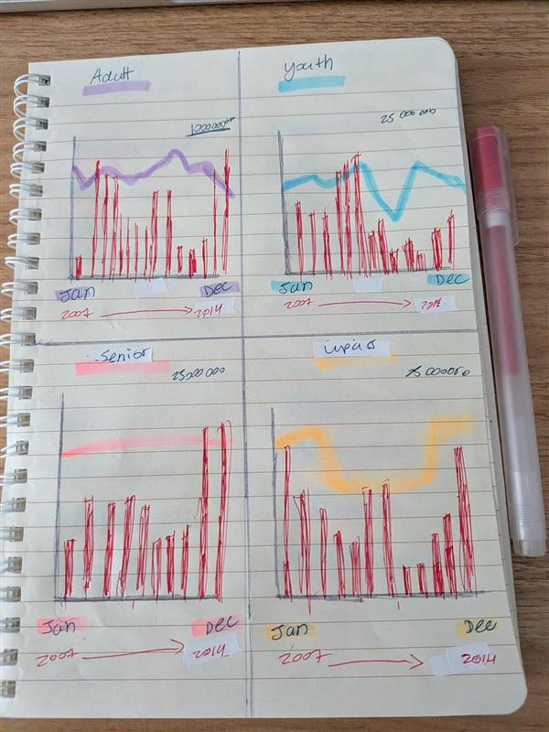
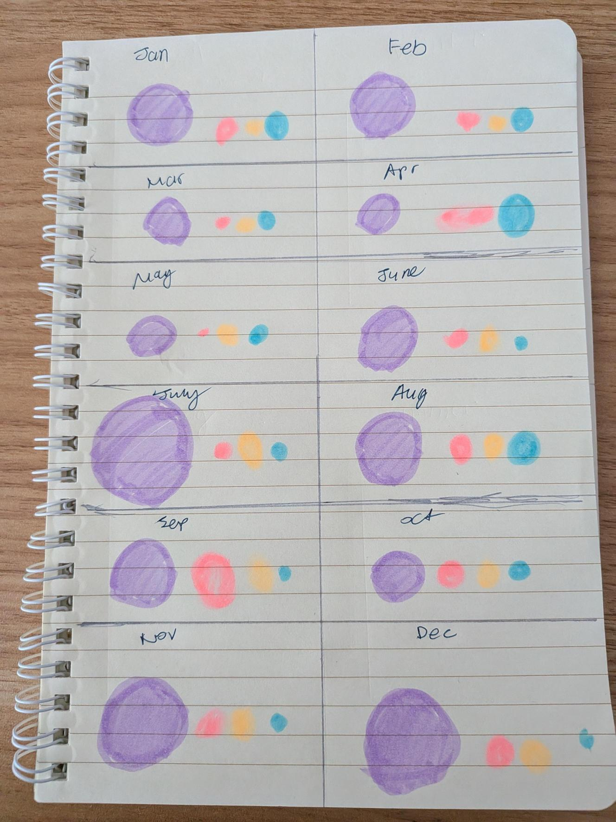
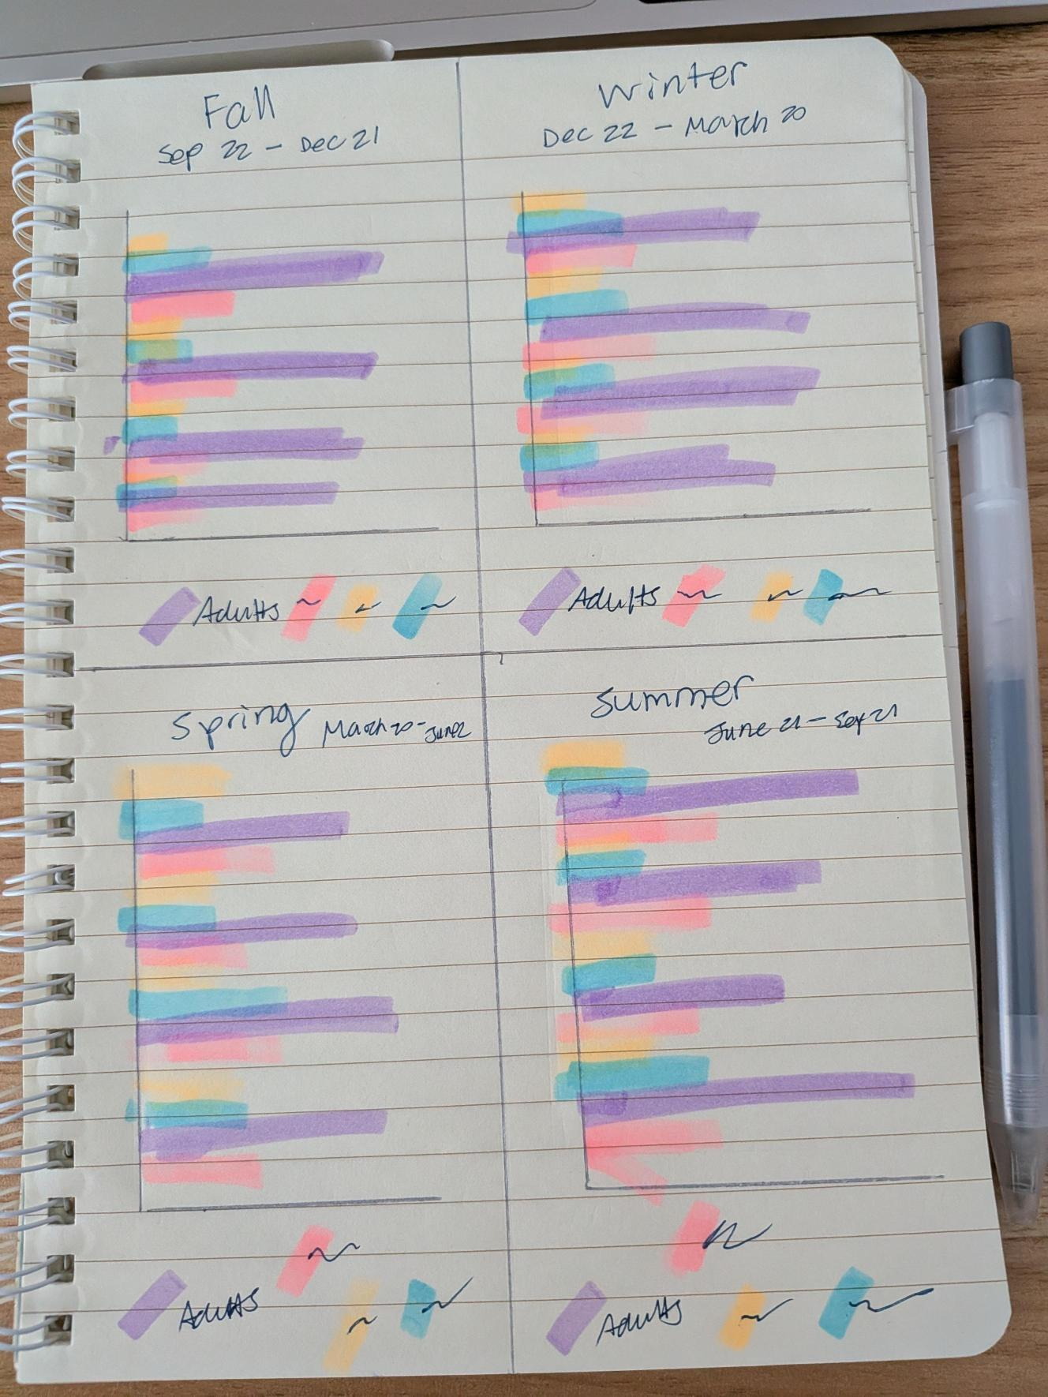
The design process
Notes:
I started with exploratory charts comparing all the fare types and modes.
I experimented with dividing and grouping my data by different months, seasons, years and the subgroups and also combining them all together

Slide 5
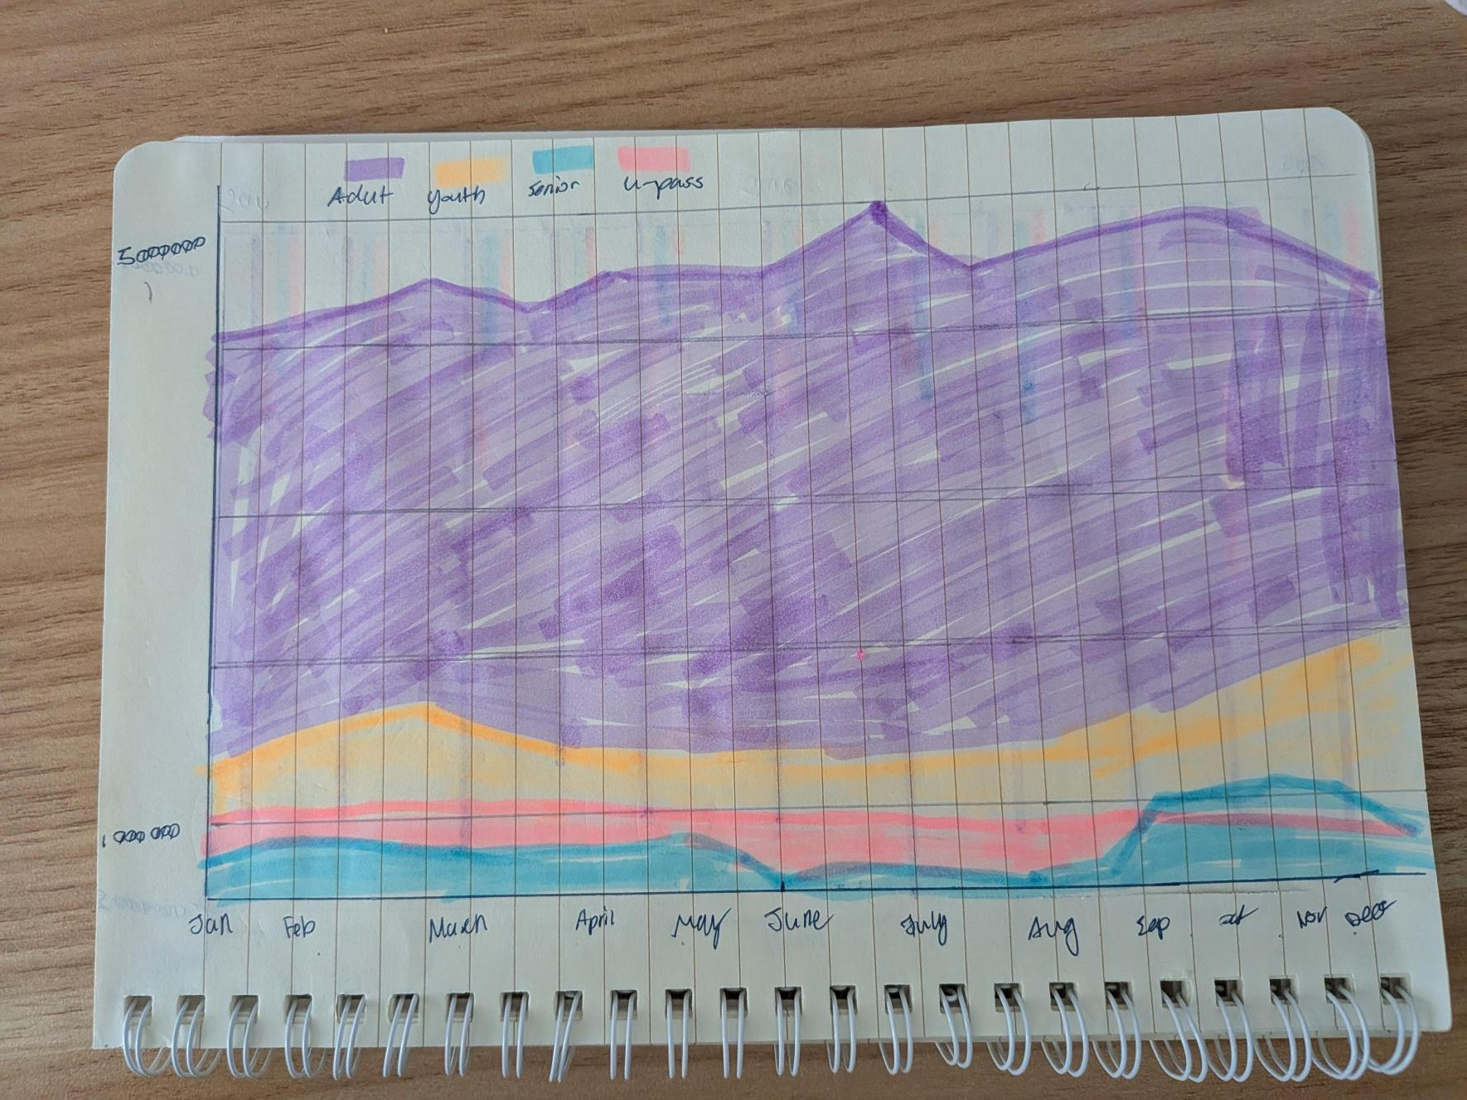
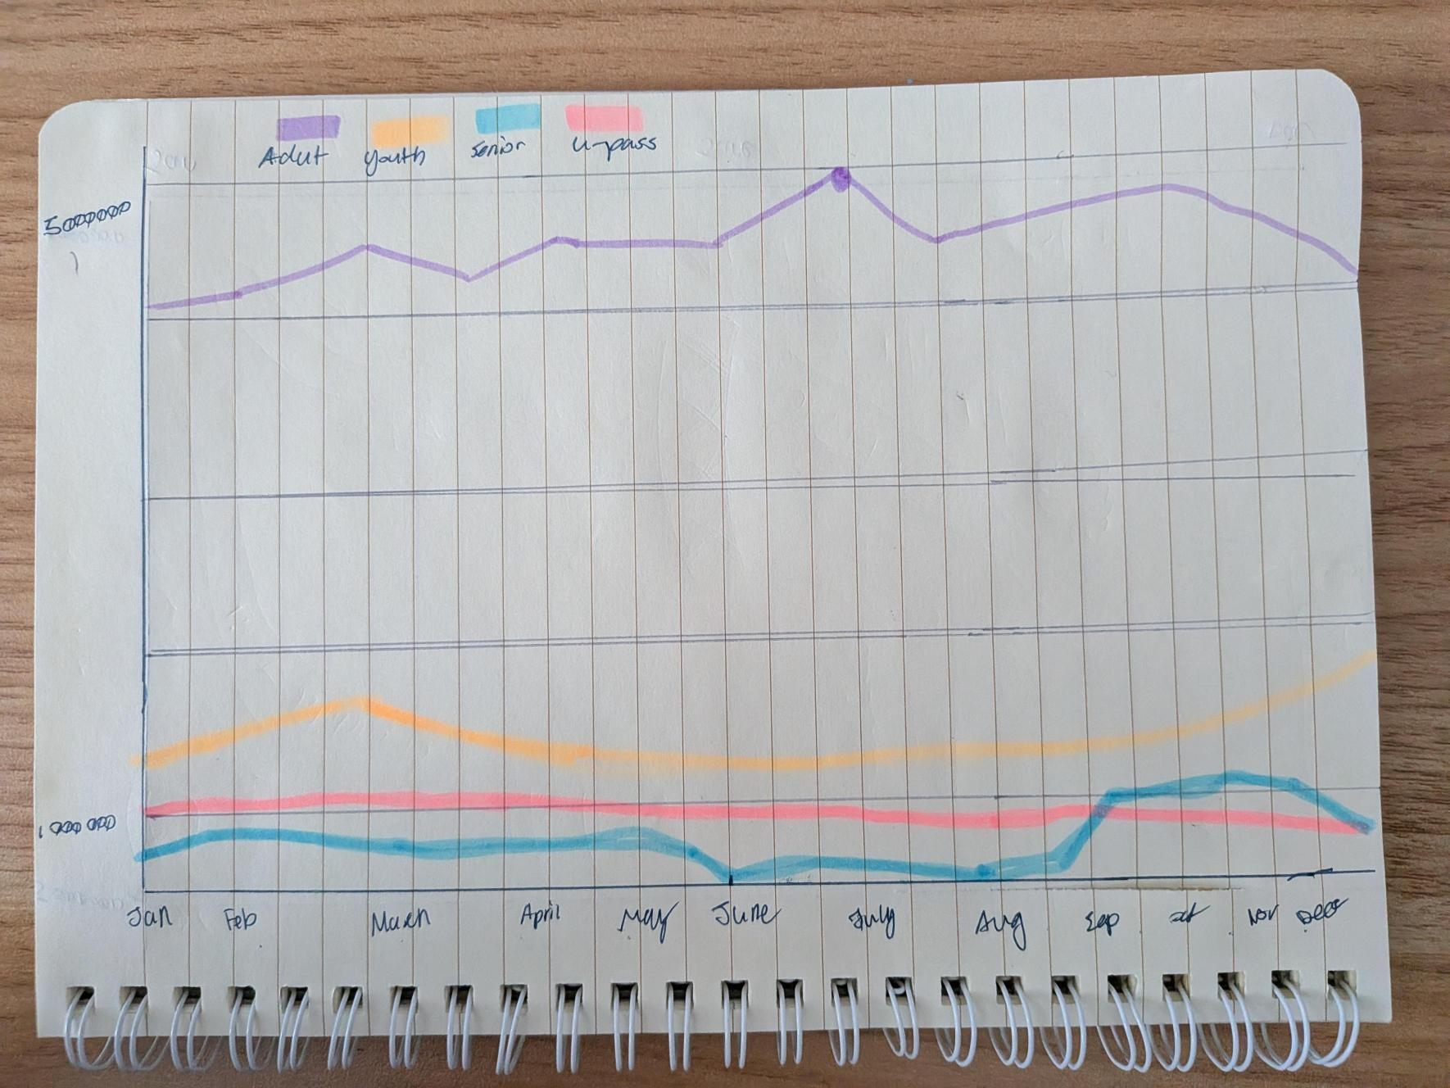
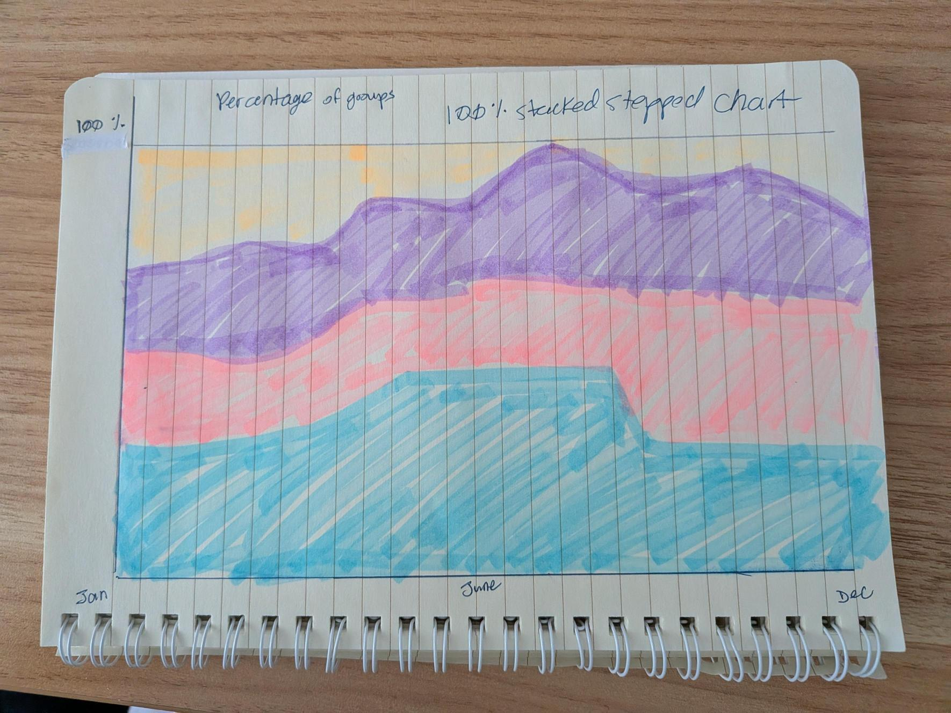
Sketches
Notes:
I tried many graph types combined multi-axis layouts. However, my friends and family found the multi-axis designs overwhelming to read. This feedback made me realize that simple and clean charts were far more effective.

Slide 6
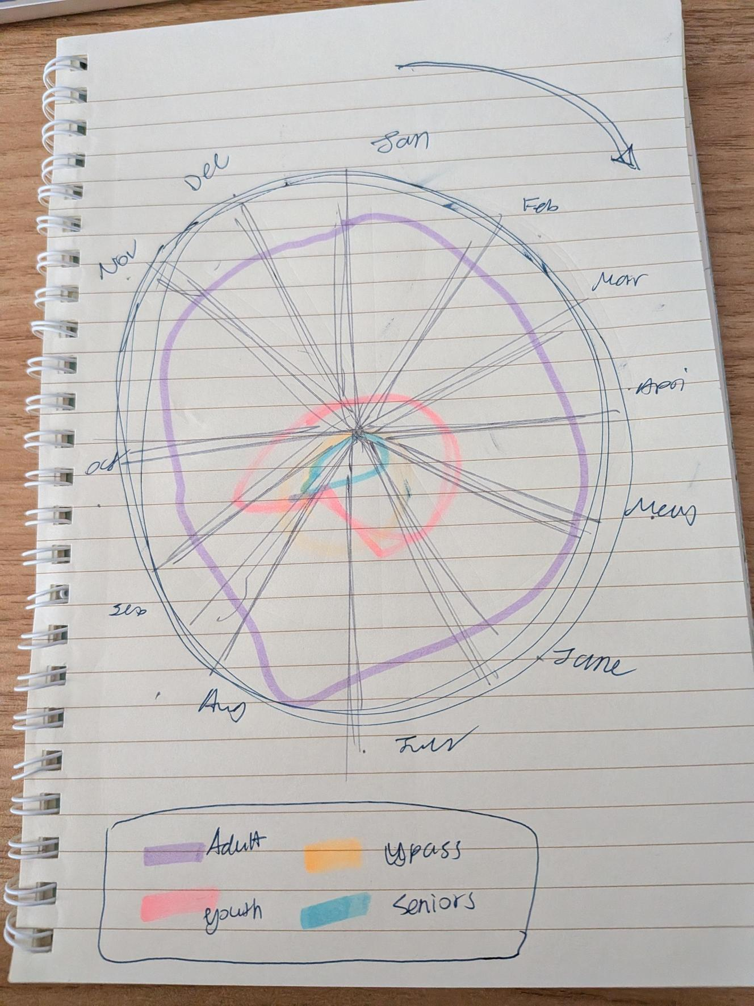
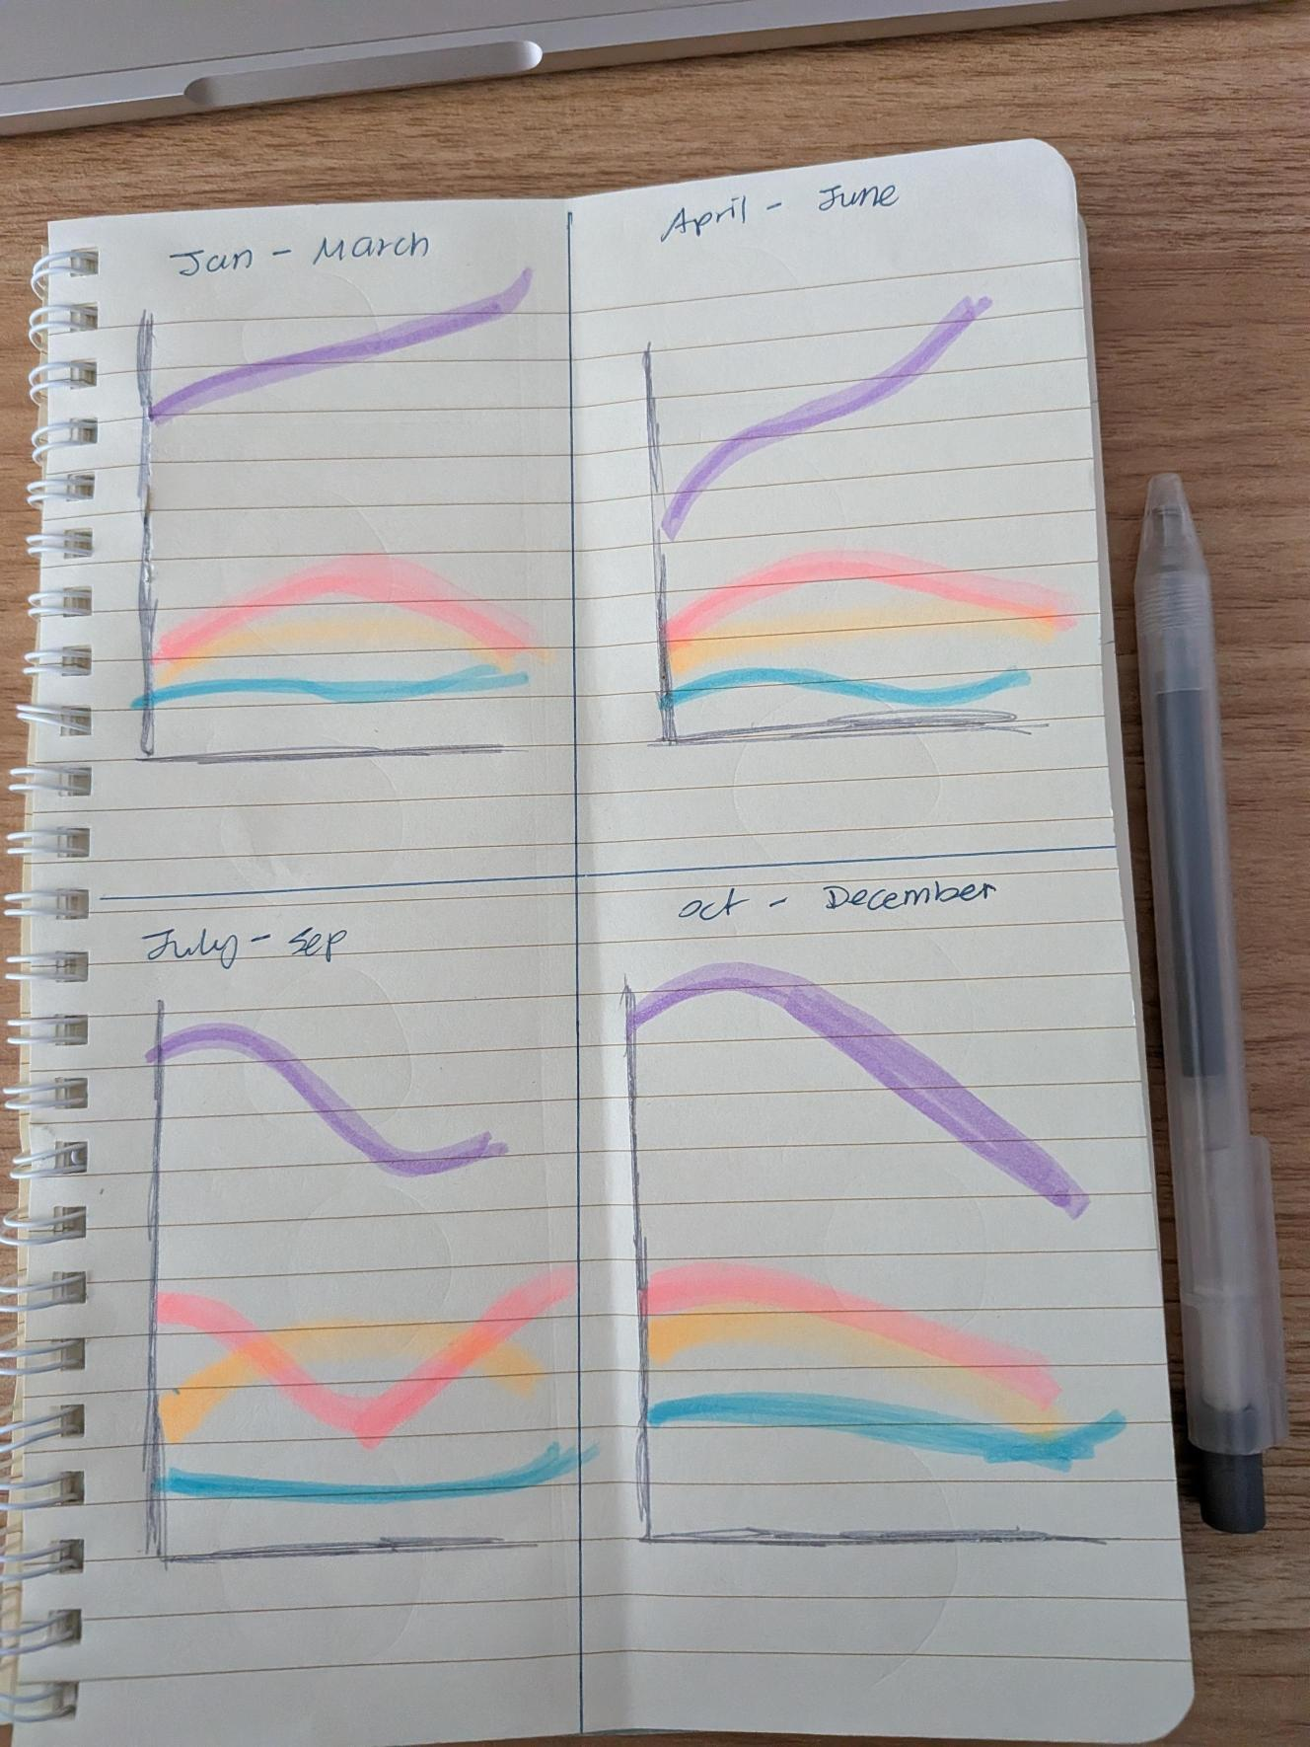
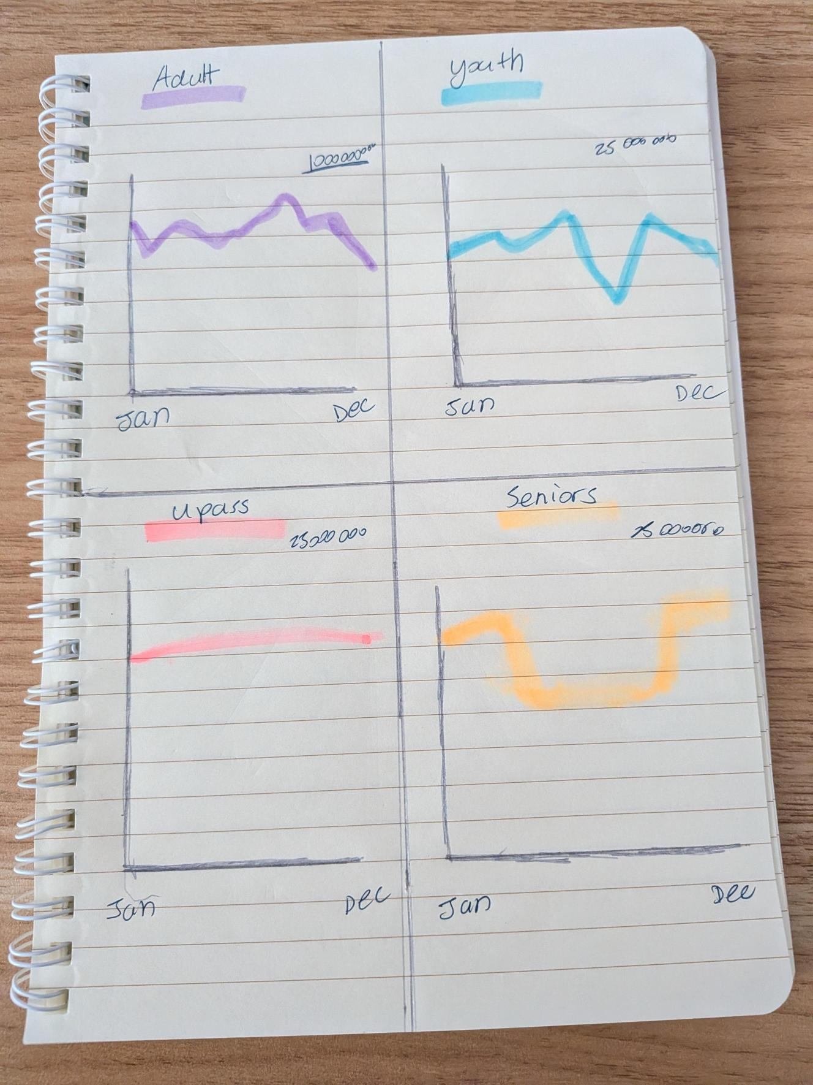
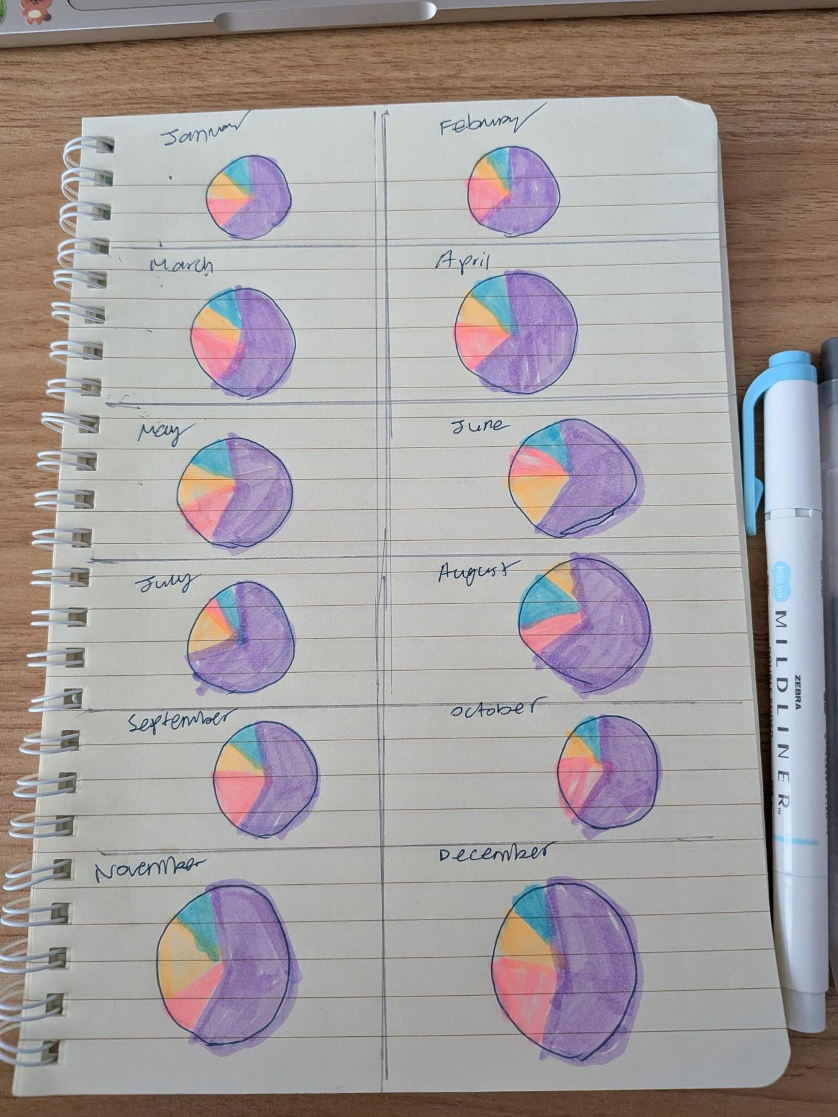
More sketches
Notes:
Another challenge was visual balance. Adult ridership vastly outnumbered the other three subgroups which flattened the scale for the other groups.

Slide 7
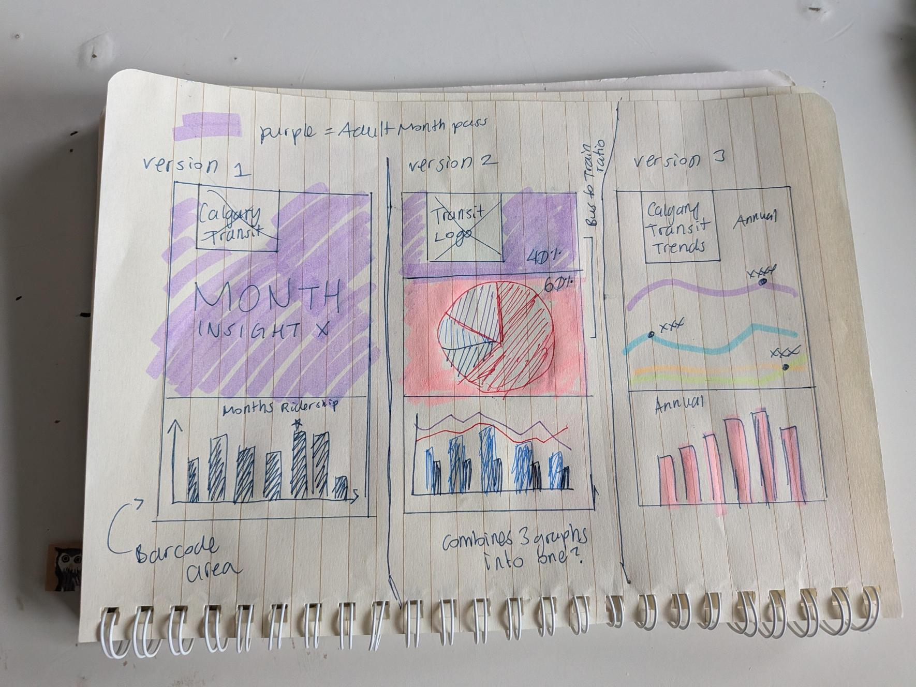
Notes:
After I decided on the graph type I would use, I then started playing around with laying the graphs out inside the Monthly Pass

Slide 8
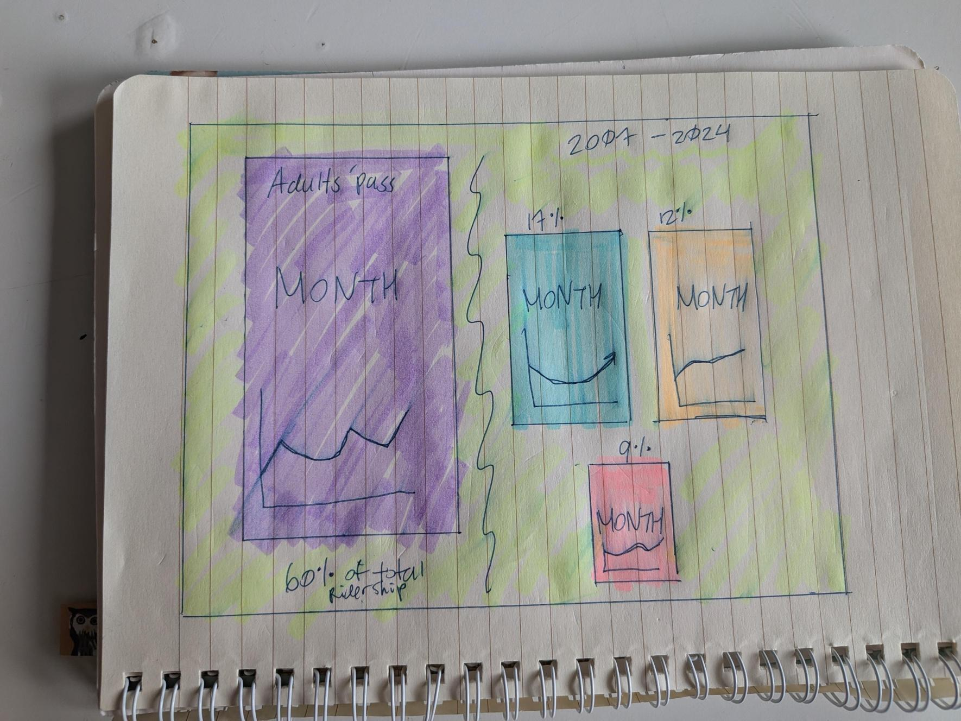
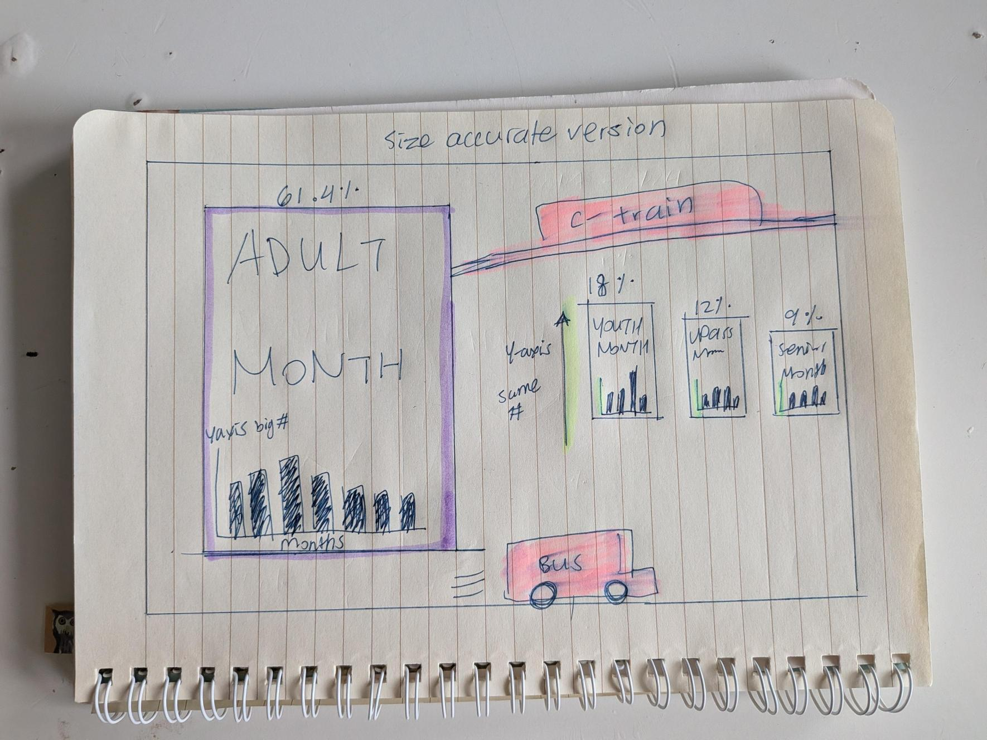
Concept sketches
Notes:
The Critique feedback session also pushed me to prioritize real-world readability. So I printed physical test proofs because I’ve never printed anything on the Tabloid paper

Slide 9
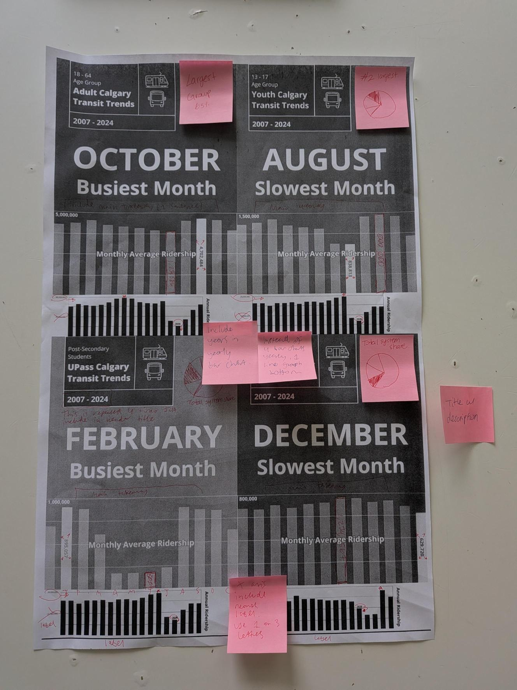
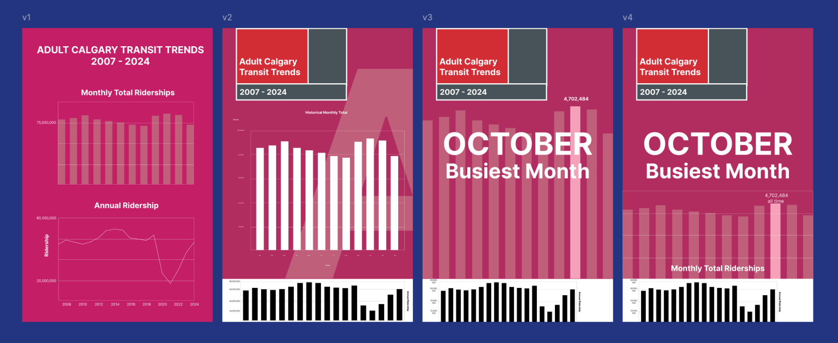
Ideation
Notes:
So I wanted to make sure that the font sizes were legible and I also tested a black-and-white version to ensure the charts worked for viewers with color-blindness by doing a contrast check on that version.

Slide 10
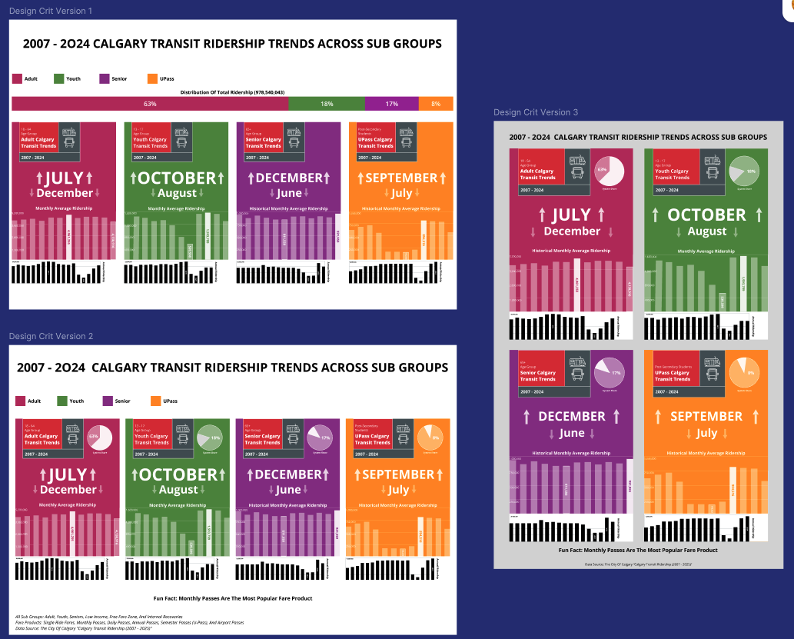
And then there were 3…
Notes:
I had 3 versions that I was struggling deciding between near the end.
The Design Critique session feedback was also super helpful when I was deciding between how to layout my design at this phase.
Everyone in the group agreed that version 1 is the easiest from at first glance, I also found out that the extra pie charts inside each of the passes were not as effective as the large bar on the top to show the overall ridership distribution. People also liked the fun fact I had included.

Slide 11
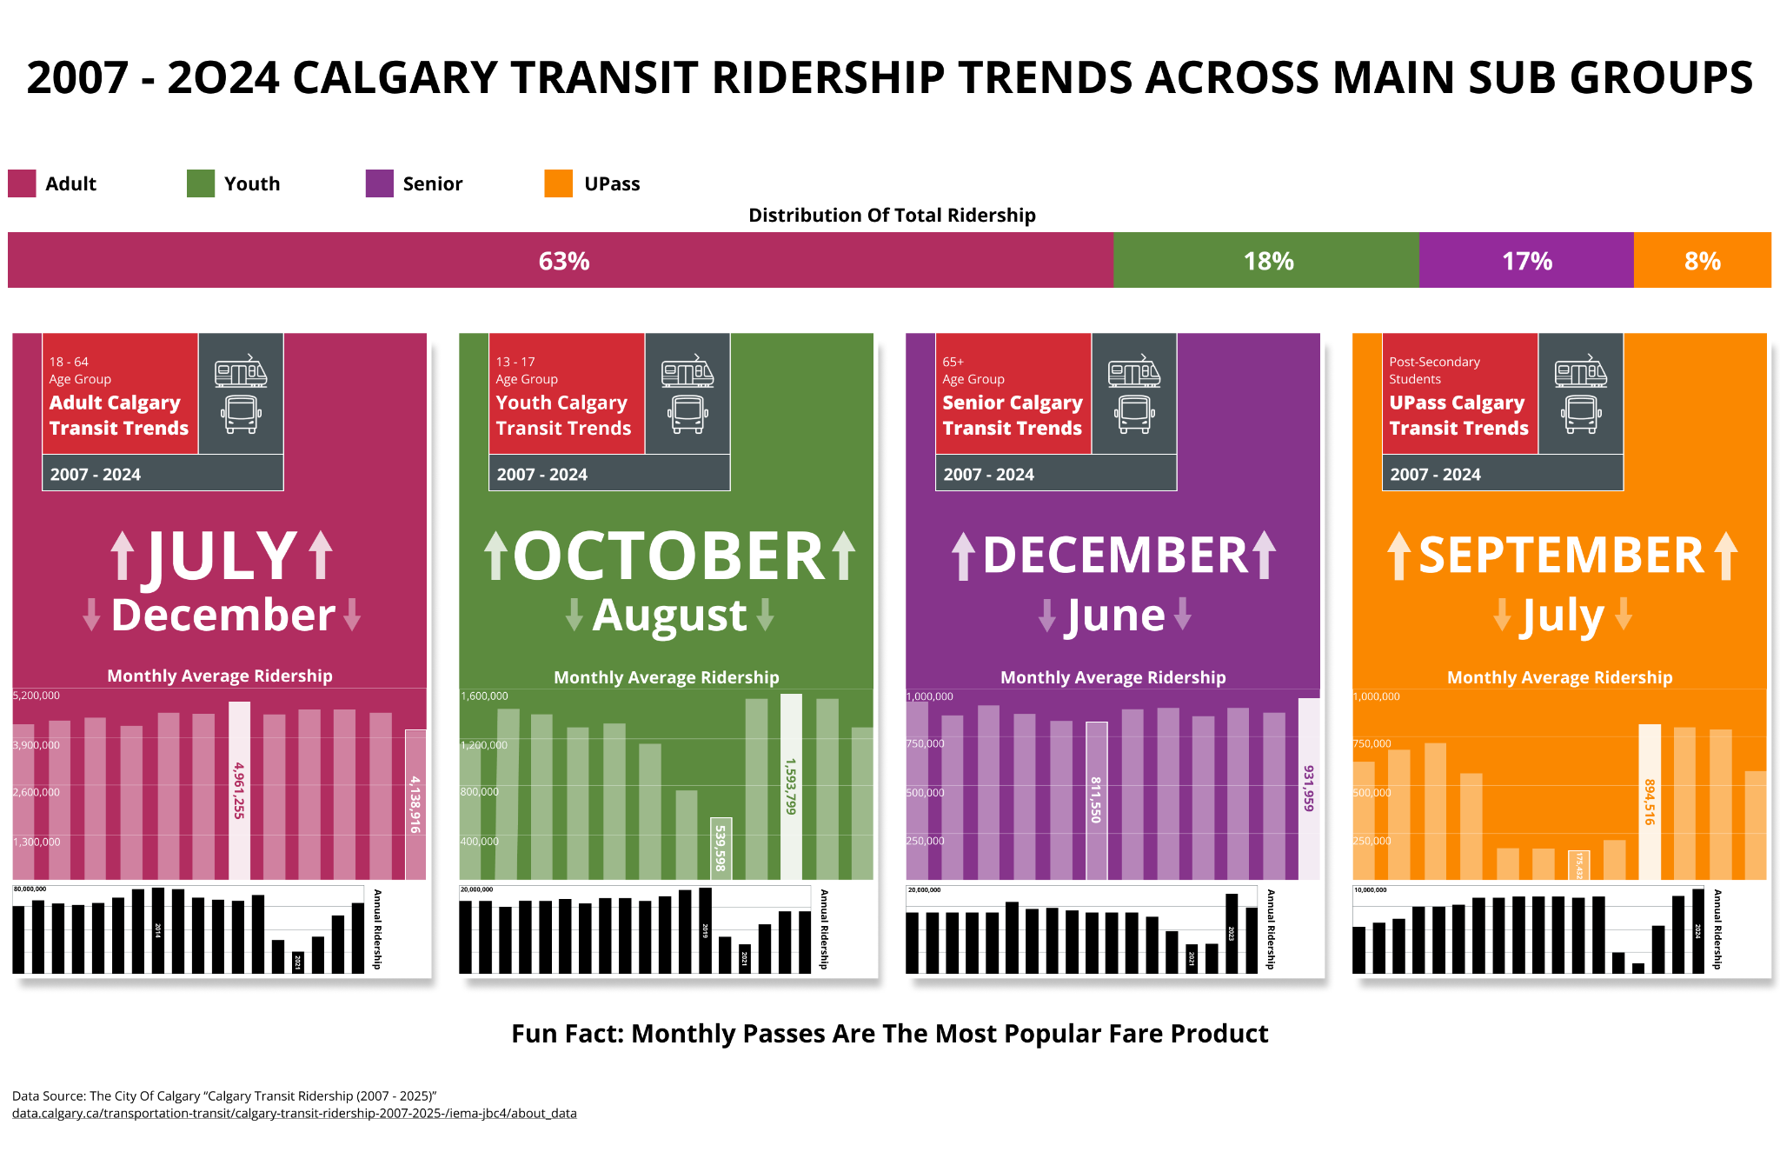
Notes:
Here is the final product I used the City of Calgary official branding, colours, fonts icons my visualization
So in the top left in the pass, is where the City’s logo would originally be. I placed equal-sized C-Train and bus icons to symbolize their equal share of usage.
Each pass clearly labels the overall average peak and low months across the 17-year span.
At the bar code area is where I put the annual trends because everyone can deduce that covid had a major impact on the total ridership amount I did not feel the need to have to emphasize it.
Ultimately, I want viewers to walk away with a clear understanding of how Calgary transit users moves throughout the months and years, demonstrating that effective data visualization isn't about complex charts—it's about meeting your audience with engaging, fun, clarity and a familiar design.

Slide 12
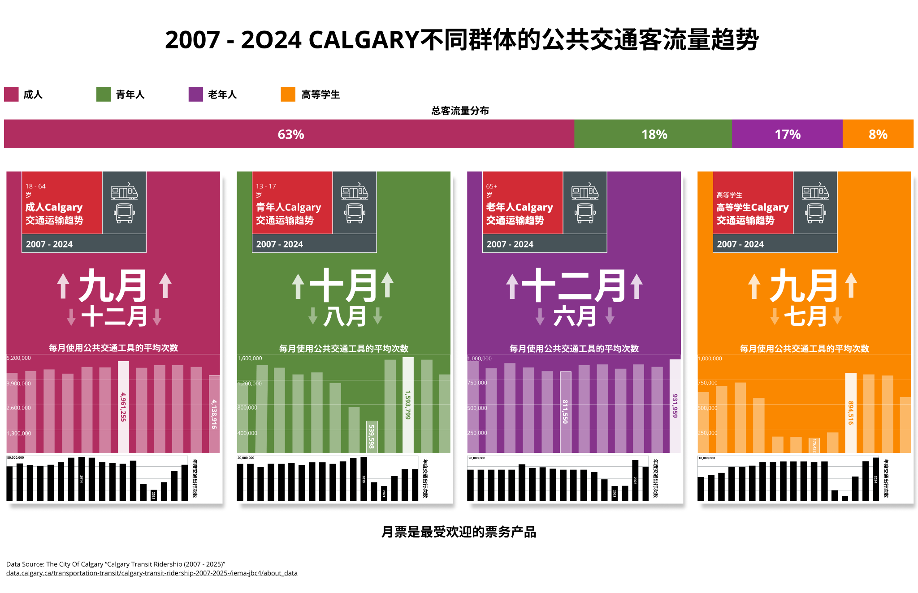
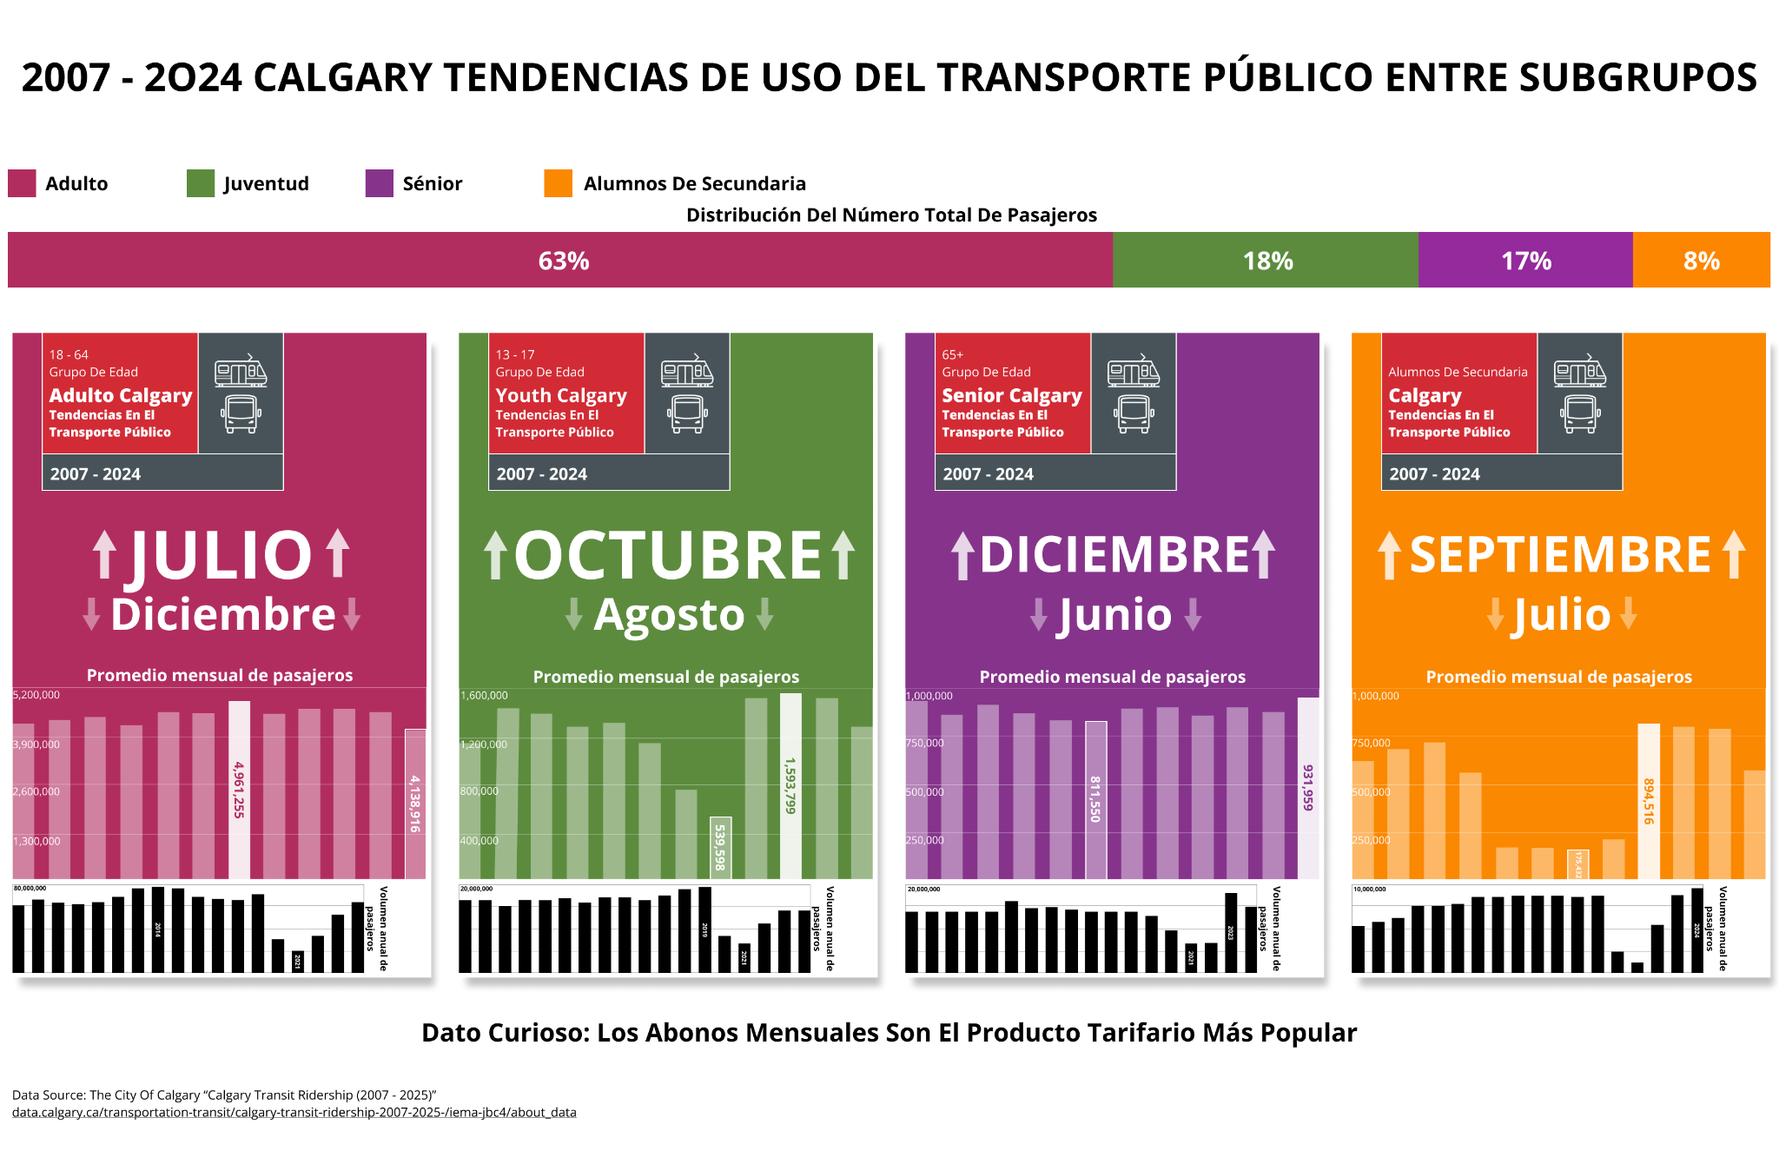
Notes:
Because Chinese and Spanish are the most spoken languages hereafter Punjabi and Tagalog according to CBC News, I made translated editions— Since I can read and speak chinese I verified that version, my partner is a native spanish speaker so he helped with that one

